Slide 1
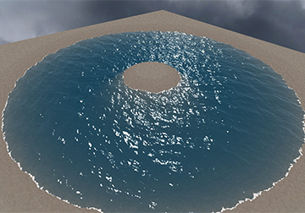
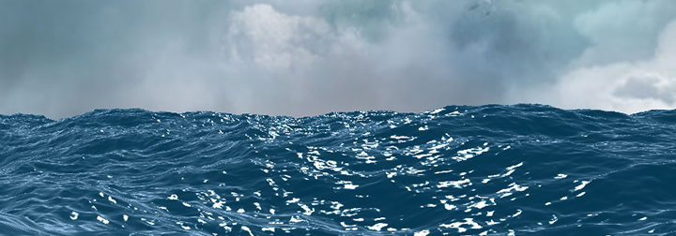
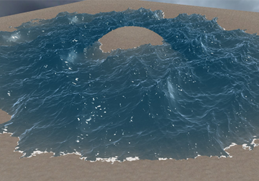
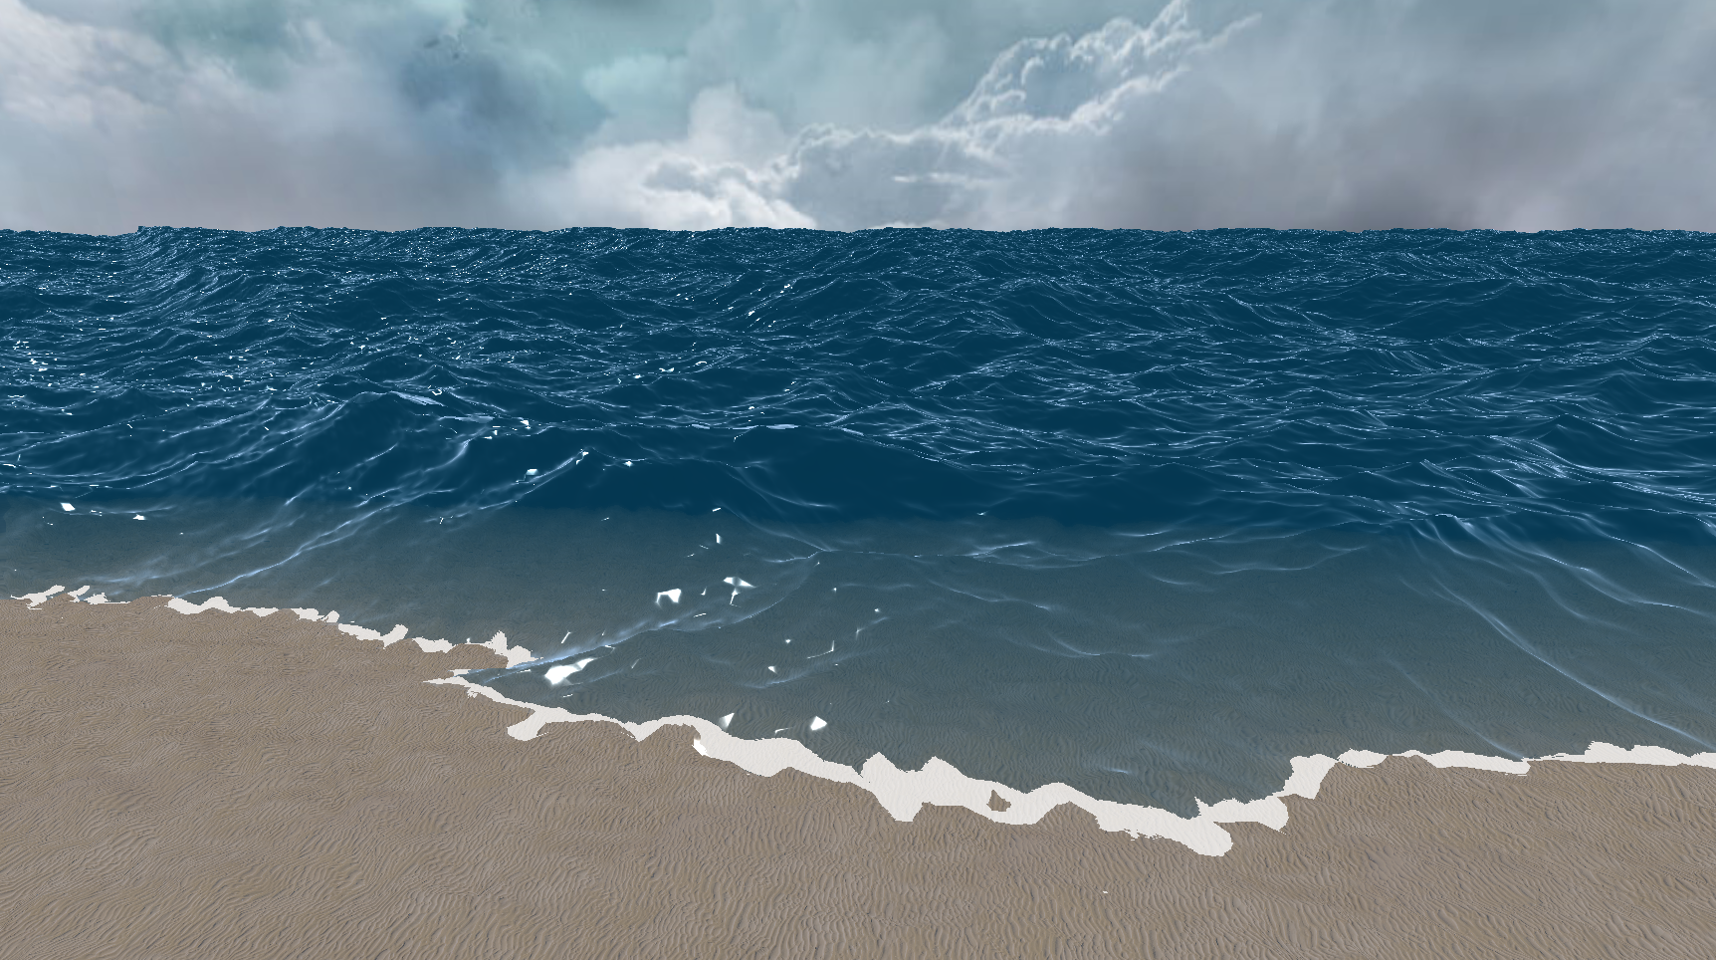
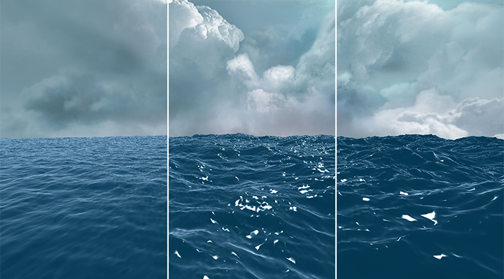
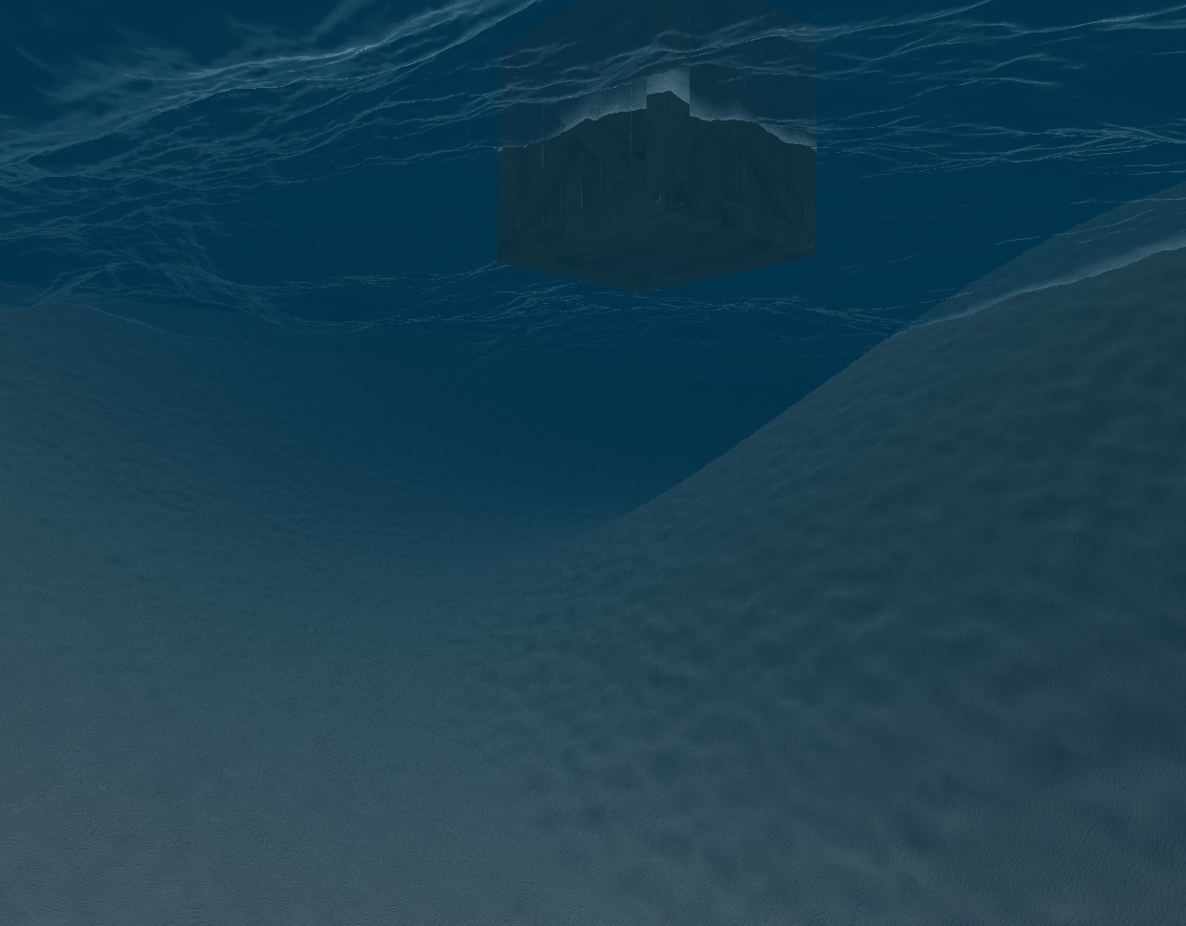
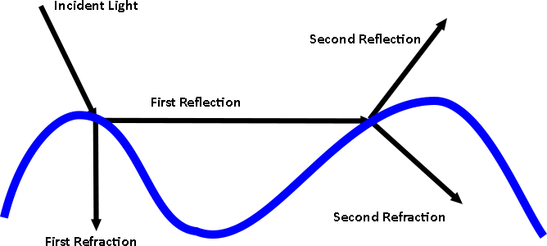
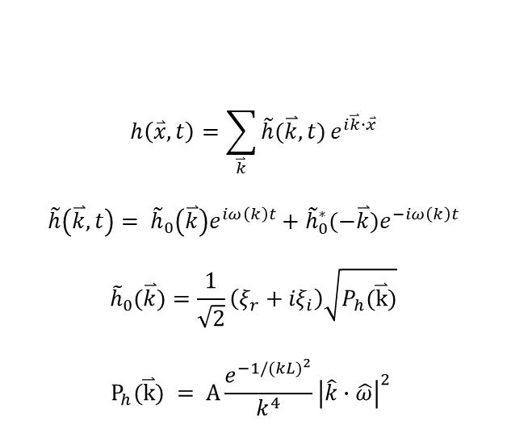
Large Scale Ocean Rendering and Simulation
Spencer McKean
Project Description
Inspired by the large and magnificent ocean in the game Sea of Thieves, I wanted to recreate the same feeling of awe in my own game engine.
Using the Fast Fourier Transform to simulate the movement of water and utilizing the DirectX11 shader pipeline to recreate the appearance of water, I achieved something close to what Sea of Thieves created.
Fast Fourier Transform Wave Surface Simulation
Based on ocean surface statistical models
Allows for more complex surfaces than other methods currently used in the industry
Exposure to different real-world variables allows for easy modification from external sources
$$h\left(\overset{⃑}{x},t\right)=\sum_{\overset{⃑}{k}}{\tilde{h}(\overset{⃑}{k},t)}e^{i\overset{⃑}{k}∙\overset{⃑}{x}}$$
$$\tilde{h}\left(\overset{⃑}{k},t\right)= {\tilde{h}}_{0}\left(\overset{⃑}{k}\right)e^{iω\left(k\right)t}+{\tilde{h}}_{0}^{∗}(−\overset{⃑}{k})e^{−iω\left(k\right)t}$$
$${\tilde{h}}_{0}(\overset{⃑}{k})=\frac{1}{\sqrt{2}}\left(ξ_{r}+{iξ}_{i}\right)\sqrt{P_{h}(\overset{⃑}{k})}$$
$$P_{h}(\overset{⃑}{k}) = A\frac{e^{−1/{(kL)}^{2}}}{k^{4}}{\left|\hat{k}∙\hat{ω}\right|}^{2}$$
Rendering: Reflectivity and Transmissivity
Light interaction with water is complex
Every time light hits the water a portion of it is reflected and another is transmitted
Refraction of light as it passes through water is dictated by the lights angle of incidence

